Slide 1
NEUROCOGNITIVE DISORDERS
DEMENTIA

Slide 2
Definition
A global impairment of higher cortical functions including memory, capacity to solve problems of daily living, performance of learned perceptuomotor skills, correct use of social skills and control of emotional reactions.
- No clouding of consciousness.
- The course is often irreversible and progressive.

Slide 3
Terminology
Deriving from Latin (demens – mad)
In psychiatry, used to be termed dementia, now called major neurocognitive disorder
“Early onset” – before the age of 60, often familial, more common for Frontotemporal dementia (FTD)
“Late onset” – after the age of 60

Slide 4
Diagnosis: DSM-V Criteria for Major Neurocognitive Disorder
Evidence of significant cognitive decline from a previous level of performance in one or more cognitive domains*:
Learning and memory
Complex attention
Language
Perceptual-motor
Executive function
Social cognition
Notes:
Important to recognize that memory decline in itself is not enough to indicate a diagnosis of dementia.

Slide 5
DSM-V Criteria for Major Neurocognitive Disorder cont.
B. The cognitive deficits interfere with independence in everyday activities.
At a minimum, assistance should be required with complex instrumental activities of daily living, such as paying bills or managing medications

Slide 6
DSM-V Criteria for Major Neurocognitive Disorder cont.
C. The cognitive deficits don’t occur exclusively in the context of a delirium
D. The cognitive deficits aren’t better explained by another mental disorder

Slide 7
DSM-V Criteria for Major Neurocognitive Disorder cont.
* Evidence of decline is based on: concern of the individual, a knowledgeable informant, or the clinician that there has been a significant decline in cognitive function and a substantial impairment in cognitive performance, preferably documented by standardized neuropsychological testing or in its absence another quantified clinical assessment.

Slide 8
Subtypes
“Early onset” – before the age of 60, often familial, more common for Frontotemporal dementia (FTD)
Strong genetic link
Tends to progress more rapidly
“Late onset” – after the age of 60
Represents majority of cases

Slide 9
Common syndromes encountered in dementia
1. Memory impairment
2. At least one of the following:
Aphasia-inability to understand or use language
Apraxia-inability to make purposeful movt/motor activities
Agnosia-inability to recognize objects by use of senses
Disturbance in executive functioning: difficulty with planning, initiating, sequencing, monitoring, or stopping complex behaviors
3. Disturbance in 1 and 2 interferes with daily function or independence
4. All of the above contribute to loss of instrumental activities of daily living

Slide 10
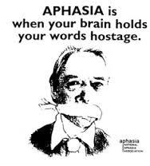
Aphasia
Problems with language, comprehension
Initially characterized by fluent aphasia
Able to initiate and maintain conversations
Syntax and grammar intact but speech is vague with nonspecific phrases like “the thing”
Later language can be severely
impaired with mutism, echolalia

Slide 11
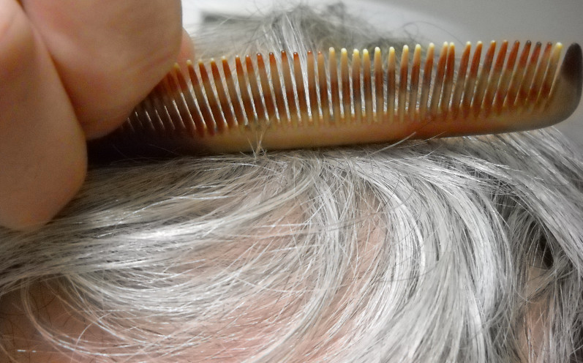
Apraxia
Inability to carry out motor activities previously able to do despite intact motor function
Contributes to loss of ADLs

Slide 12
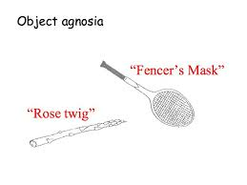
Agnosia
The inability to recognize or identify objects despite intact sensory function
Typically occurs later in the course of illness
Can be visual or tactile

Slide 13
ADL and IADL
Instrumental activities of daily living (IADL)
Using a phone
Travel
Shopping
Preparing meals
Housework
Medication management
Money management
Activities of daily living (ADL)
Bathing
Dressing
Grooming
Toileting
Continence
Transferring

Slide 14

Cognitive decline AND associated neuropsychiatric symptoms lead to increasing dependence on others and often eventual institutionalization

Slide 15
Initial Interventions
WHEN
Someone presents with cognitive problems

Slide 16
The work up
Thorough history (medical, psychiatric, neurological)
Get collateral!! Are ADL/IADLs affected?
Physical and neurological exam
Cognitive testing (screening, then more detailed if needed)
Labs and imaging (rule out reversible causes)
Consider neuropsychological testing or referral to psychiatry or neurology
Determine the etiology/establish the diagnosis
Treat! (or refer)

Slide 17
Cognitive screening tests
Mini-Mental Status Exam (MMSE)
Mini-Cog – combines clock drawing and three item memory test.

Slide 18
Screening test: MMSE
Useful to have at baseline
Can track changes over time
In Alzheimer’s, patients lose 3 points/year
Careful of false positives in those with little education
Careful of false negatives in those with high premorbid intellectual functioning

Slide 19
Screening test: MINI-COG
Instruct the patient to listen carefully to and remember these 3 words: banana-sunrise-chair
Instruct the patient to draw the face of a clock, after the numbers are placed, ask them to draw the hands of the clock to read “quarter past ten.”
Ask the patient to repeat the 3 previously stated words.

Slide 20
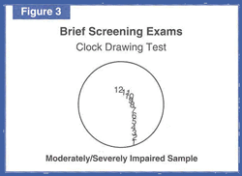
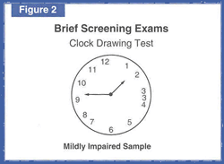
Clock Drawing Test--abnormal
Notes:
Here are a few examples of the Clock Drawing Test.
The clock on the left would be considered abnormal due the assymmetry of the digits on the clock.
The one on the right shows a more severe impairment.
Neither of these would be considered “normal”

Slide 21
Lab-work
LFTs
B12, Folate
HIV
…………………………..
…………………………..
……………………………
Others only if clinical suspicion is high

Slide 22
Imaging
CT Scan
MRI

Slide 23
“reversible” dementias
Drug toxicity
Metabolic disturbance
Normal pressure hydrocephalus
Mass lesion (tumor, subdural hematoma)
Infection (meningitis, syphilis)
Collagen-Vascular disease (SLE, Sacroid)
Endocrine disorder (thyroid, parathyroid)
Nutritional disease (B12, thiamine, folate)
Other (COPD, CHF, Liver disease, apnea…)
Only 9% are potentially reversible
Only 0.6% actually reverse with treatment

Slide 24
Dementia syndromes
Alzheimer’s disease
Vascular dementia Commonest types
Korsakoff’s
Lewy body dementia (LBD)
Parkinson’s disease dementia (PDD)
Fronto-temporal dementia (FTD)
Mixed pathology

Slide 25
Alzheimer’s disease
Insidious onset, gradual progression, incidence age-related
Short term memory problems on presentation
Most common dementing illness
Ultimate diagnosis based on pathology of neurofibrillary tangles and senile plaques

Slide 26
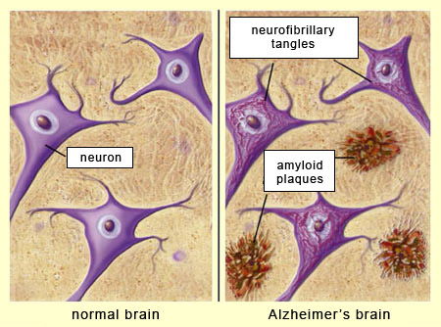

Slide 27
Treatment
Address cognitive dysfunction
Address neuropsychiatric symptoms
Address the needs of the caregiver and the dyad of patient/caregiver
Consider the environment/living situation

Slide 28
Treatment: Cognitive dysfunction
Acetylcholinesterase inhibitors– use in all stages of AD, earlier is better (but not in mild cognitive impairment)
Memantine – for moderate to severe stages of the disease
Consider cognitive interventions (stimulation, rehabilitation, training)
Physical exercise

Slide 29
Neuropsychiatric symptoms
Agitation
Aggression
Depression
Anxiety
Psychosis
These symptoms are distressing and disruptive for the patients and their caregivers.
Agitation and aggression are the reasons why patients end up hospitalized/institutionalized.
Caregiver support and psychoeducation may prevent such outcomes.

Slide 30
Treatment of neuropsychiatric symptoms
Nonpharmacological approaches should be tried first!
And even before that, psychiatric/medical causes of agitation must be ruled out
Identify precipitating/contributing factors to agitation/anxiety
Teach caregivers how to do the same and provide them with support
Address the unmet needs of the patient
Allow the patient to remain as independent as possible when helping them with ADLs
Notes:
An unmet psychological need for increased social contact, environmental exposures to violence,

Slide 31
Pharmacologic options
Use medications when nonpharmacological methods failed, or succeeded only partially, or when high risk/violence exist

Slide 32
Options for treatment of agitation
Acetylcholinesterase inhibitors and memantine – not great when effect needed urgently
Atypical antipsychotics (modest efficacy)
Antidepressants – citalopram etc
Carbamazepine – (consider numerous side effects and drug interactions)
Propranolol, prazosin – (consider falls)
Benzodiazepines – emergent use only

Slide 33
Treatment of depression, psychosis
Antidepressants for depression in dementia are somewhat controversial.
For severe depression/suicidality, consider hospitalization, consider ECT
Treatment of hallucinations/delusions is not always needed – but when it is, start antipsychotics (atypical) slowly and titrate gradually
Use quetiapine preferentially

Slide 34
Other treatment options for neuropsychiatric symptoms
Recommend psychotherapy, exercise, pleasurable activities, support groups, memory aids
Minimize changes in caregivers/environment
Music therapy is gaining strength as evidence based intervention for treatment of anxiety

Slide 35
Summary points
It is paramount to diagnose dementia!
Always obtain collateral from caregivers, and provide them with education and support
Evaluation of cognitive function is key
Earlier treatment preserves functioning
Correct diagnosis prevents poor outcomes
Neuropsych sx are common and are best addressed with nonpharmacological strategies
Use cognitive enhancing medications whenever possible
Use medications for agitation/neuropsych sx when unavoidable

Slide 36
THANKS

